Slide 1


Malicious URL Classifier
A SUPERVISED MACHINE LEARNING APPROACH FOR DETECTING ZERO-DAY PHISHING ATTACKS.
DEEPU R
AA.SC.P2MCA24077088
AMRITA VISHWA VIDYAPEETHAM

Slide 2
Problem Statement & Motivation
LIMITATIONS OF TRADITIONAL APPROACH
  The Problem: Traditional firewalls rely on static "Blocklists" (Blacklisting). They can only stop known threats.
  The Gap: Hackers use Domain Generation Algorithms (DGA) to create thousands of new, temporary URLs every day that existing firewall-blocklists might miss.
  The Solution: This project builds an AI engine that moves from Reactive Matching (checking a pre-entered list) to Proactive Prediction (analyzing the URL's behavior before it reaches the user).

Slide 3

Engineering Strategy
STRUCTURAL ANALYSIS
TOKENIZATION & SPECIAL CHARACTERS
HOST-BASED DETECTION
  Logic: Calculating URL length and hostname length.
  Why: Phishing links (especially widespread campaigns) tend to be abnormally long to hide the true destination on mobile screens.
  Logic: Counting occurrences of @, -, ?, and (.).
  Why: Hackers use @ to trick browsers (e.g., google.com@evil.com actually goes to evil.com).
  Logic: identifying raw IP addresses (Regex matching).
  Why: Legitimate services use DNS names; raw IPs in URLs are a high-confidence indicator of malware hosting.

Slide 4
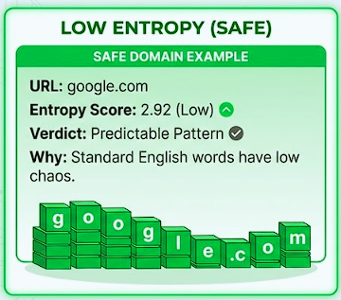
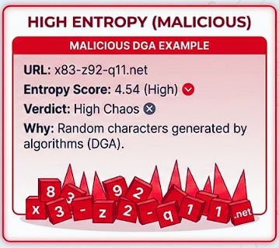
The Mathematical Core: Understanding Shannon Entropy
KEY METRIC FOR URL ANALYSIS
  Shannon Entropy calculates the Chaos Score of domain names, distinguishing readable domains from random strings, thus predicting malicious intent effectively.
  Shannon Entropy measures the randomness of character distribution. While legitimate domains follow linguistic rules, bot-generated phishing domains are mathematically chaotic.

Slide 5



Technology Stack & Tools
TOOLS FOR BUILDING THE CLASSIFIER
1. Core & Data Processing
    Python 3.x: Primary logic.
    Pandas & NumPy: For dataframe manipulation and vectorization.
    Re & Urllib: Regex for pattern matching (IP detection) and parsing URL structures.
2. Machine Learning Engine
    Scikit-Learn: Used for the Random Forest Classifier implementation.
    Matplotlib/Seaborn: For visualizing the Confusion Matrix (accuracy) and entropy data distribution.
3. Development Environment
    Visual Studio Code: IDE for coding and testing.
    Git & GitHub: For version control and cloud storage.

Slide 6
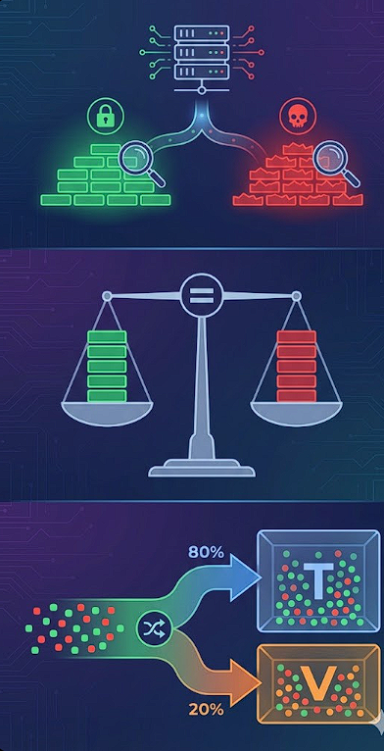
Dataset Generation & Training Strategy
CREATING A LABELED DATASET FOR TRAINING
    Synthetic Data Generation: Created a controlled dataset of 400+ URLs to simulate specific attack vectors (DGA, IP-based, Typosquatting).
    Class Balance: Maintained a strict 50:50 ratio (Safe vs. Malicious) to prevent model bias.
    Train-Test Split: Utilized an 80/20 split (80% for training, 20% for validation) to ensure the model can generalize to unseen data.

Slide 7
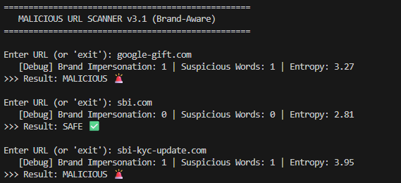
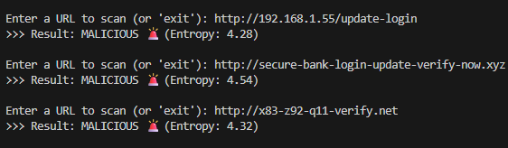
Experimental Results & Analysis
MODEL ACCURACY
  High Accuracy: "Achieved 94% accuracy on the synthetic test set using the Random Forest Classifier."
  Robust Detection: "Successfully flagged high-entropy domains (Entropy > 4.0) and raw IP-based phishing attempts."
  Real-Time Performance: "Classification speed is almost instantaneous, making it suitable for real-time firewall integration."

Slide 8


Conclusion &
Future Scope
CONCLUSION
The prototype validates that Machine Learning can successfully detect zero-day phishing attacks that static blocklists miss.
END
FUTURE ENHANCEMENTS
  WHOIS Integration: Check domain age (new domains are suspicious).
  Levenshtein Distance: Detect "Typosquatting" (e.g., g00gle vs google).
  Browser Extension: Deploy as a Chrome/Edge plugin for end-user protection.
DEEPU R
github.com/deepuramesh

